Slide 1
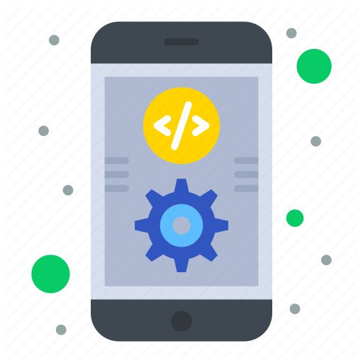

Web/Mobile Programming
ICP Presentation_TWO
Presented by:
Dharma Teja
Avinash Reddy

Slide 2
ICP Group 6
Avinash Reddy T - atfkh@umsystem.edu
Dharma Teja - dkbmy@umsystem.edu
GitHub repositories:
Avinash: WebDevCourse/MobilePart at main · avinashreddy3/WebDevCourse (github.com)
Dharma: Web-and-Mobile-programming-spring-2022/mobile part at main · Dharmateja183/Web-and-Mobile-programming-spring-2022 (github.com)
Video Link: https://youtu.be/JQbjO65Wl6s

Slide 3
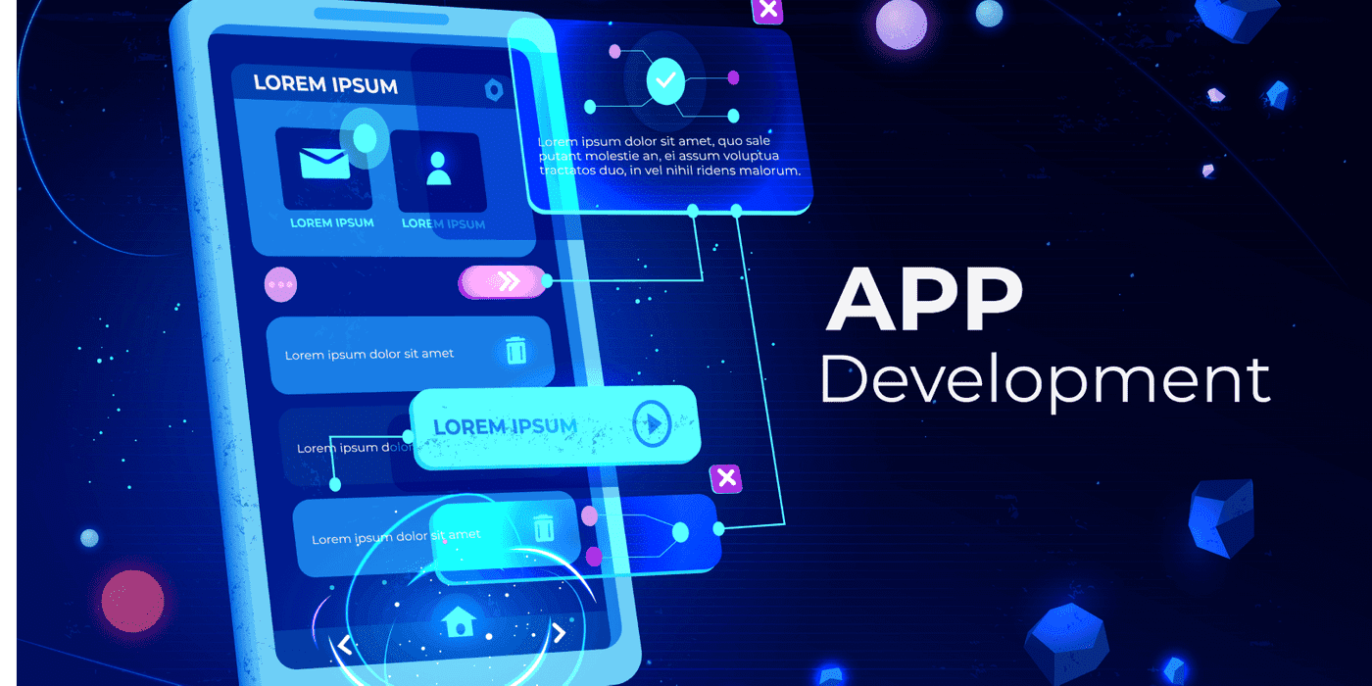
Introduction to Mobile Application development
The design of software for mobile devices that is customized to take use of the products' particular features and hardware is known as mobile app development.
Native apps, hybrid apps, and HTML5 apps are examples of the sorts of mobile apps that developers make.
Considerations:
The only way to solve a device's performance problem is to design an app that runs natively on that device. This entails writing code that is tailored to the hardware of a certain device. This is particularly simple in the case of iOS devices, as mobile developers simply need to create versions of their apps for the iPhone and iPad to gain global usability.
Each Android smartphone or tablet, on the other hand, operates on various hardware and different versions of the operating system.

Slide 4
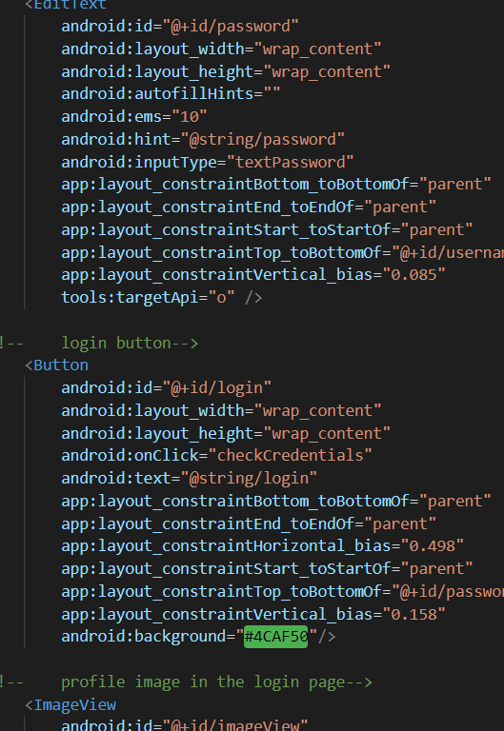
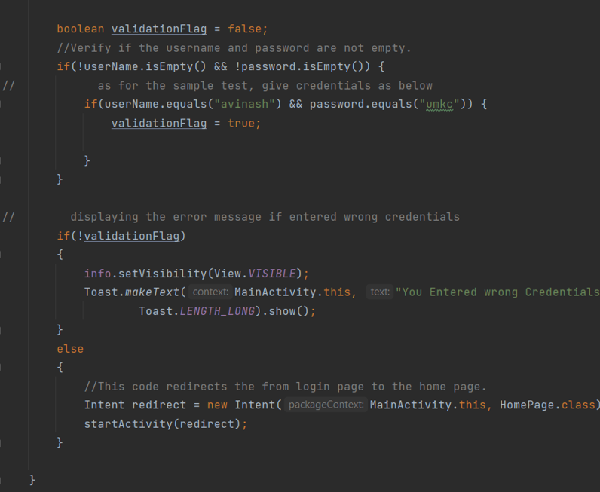
Login Application
First, we going to start about ICP 8 – Login Application.
We have created an application where user can log in, for that we used to two Editview fields to accept username and password.
And later after user successful login, we created the home page with few functionalities.
User can also sign up to the application.

Slide 5
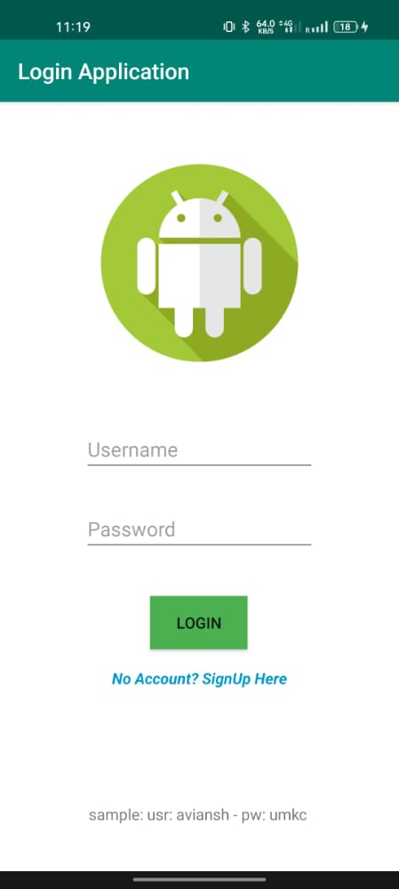
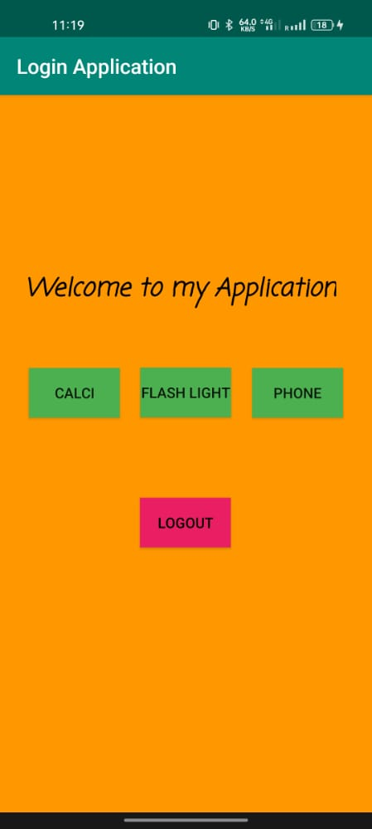
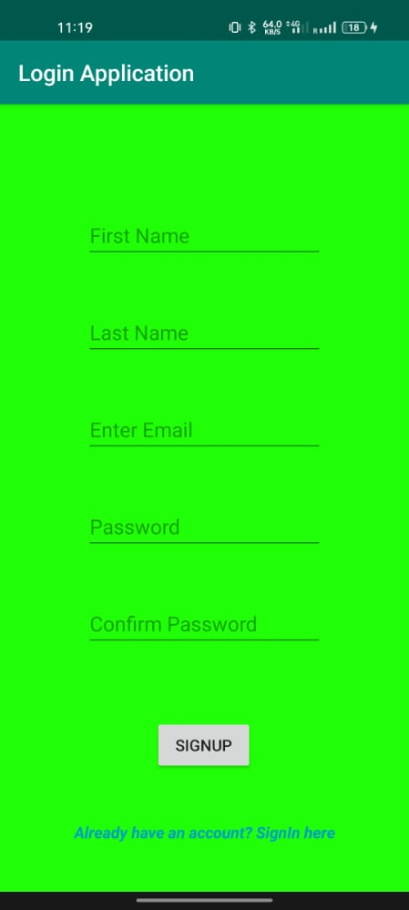
Outputs:
In the mainactivity.java file, we used java code for implementing the functionality of app.
We have used textview fields
Buttons
Edittext fields

Slide 6
Pizza Ordering Application
In this ICP 9, its mainly divided and developed as two sections:
Homepage
summary page
Features we added are:
Submit button, pizza type, quantity, text field, and checkboxes are included in the main page of our application.
Button to place an order.
Summary button to view the order details.
And main feature with our application is that we can share the order details externally with the order button itself.

Slide 7
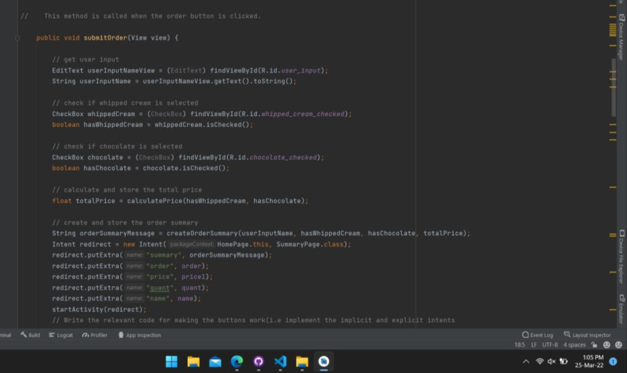
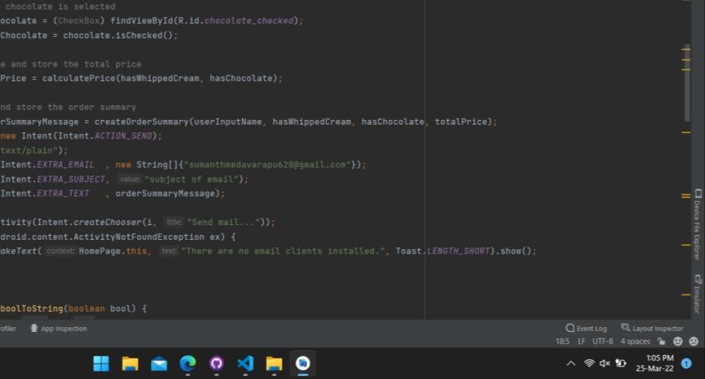
Here we have written the code to get the input from the user and also the added extra items to the order and calculated the total price finally
this snippet code written using java programming language to store the order details or summary message which can be shared externally via any platform like messaging app, email, etc. and this message is also stored on summary page.

Slide 8
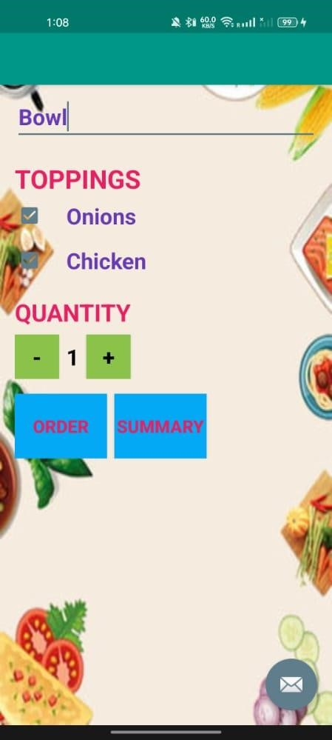
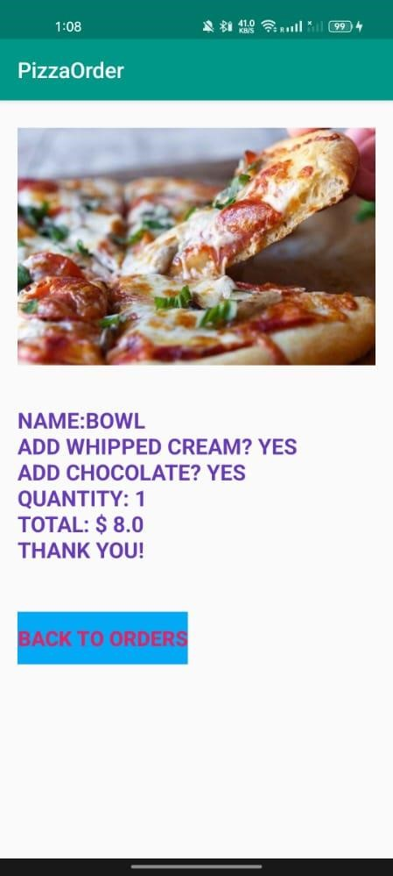
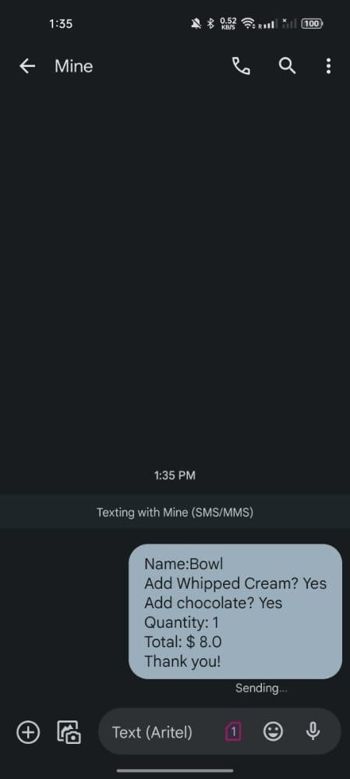
Outputs:
Finally we run our application by installing the apk version on our desired device. above is the Output of our app’s homepage view where there is an input field, toppings as an additionals to be added and two buttons and summary page and sample message sent externally.

Slide 9
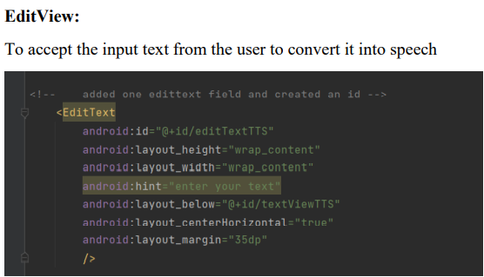
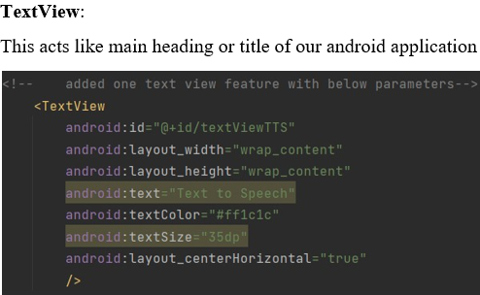
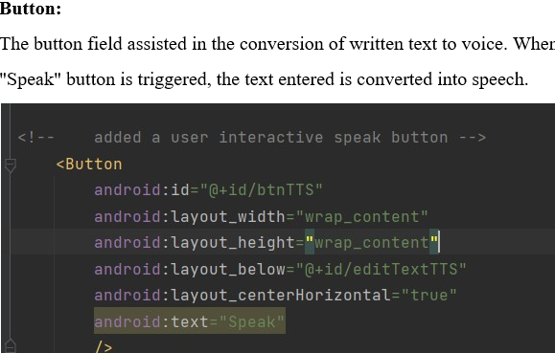
Text-To-Speech Application
In this ICP 11, we are going to utilize android studio, java programming, xml languages for mobile application development, To create an app with Text-to-Speech functionality which convert the text that is entered on the field into speech using android studio.
First, Created a TextView, button & EditText fields in android manifest.xml file.
(Adding Text-to-Speech capabilities to turn text into speech): MainActivity.java

Slide 10
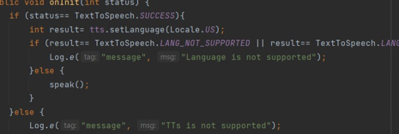
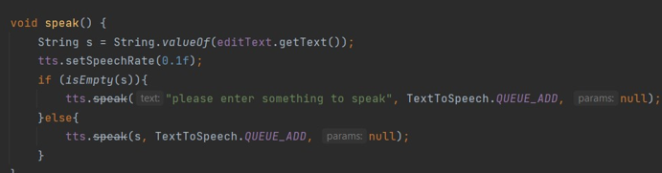
After we've finished creating the object, we've implemented validations for both success and failure scenarios.
If no errors are identified, it will execute properly and pick "Locale.US" as the language of speech. Validations for language selection have also been included.
If the specified language is incorrect or not functioning correctly, an error notice will appear. Otherwise, the text will be successfully transformed. This is shown in below screenshot.
And the next main feature is speak() method/ function which is to be triggered when clicked on the speak button on the home page.
And we have given the two scenarios here as well,
-If the text entered is empty, display a message to user to enter the text to speak -Else convert the text entered to voice.

Slide 11
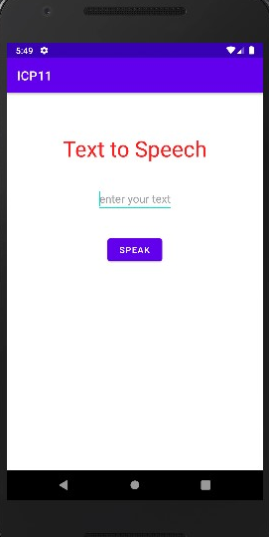
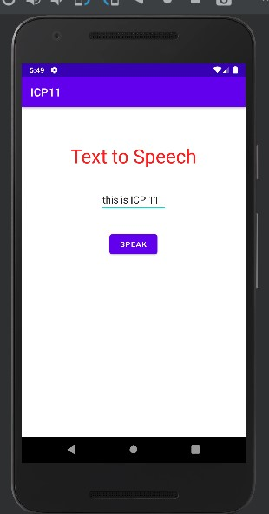
Outputs:
This is homepage of Text-To-Speech application
We have entered the text to speech, as shown below, to test. When clicked on ‘SPEAK’, you can hear the voice.

Slide 12
Thank you….!

